Slide 1
SAE S.T.A.R.S
Score Tracking and Recording System
2/14/2024
www.saestars.com

Slide 2
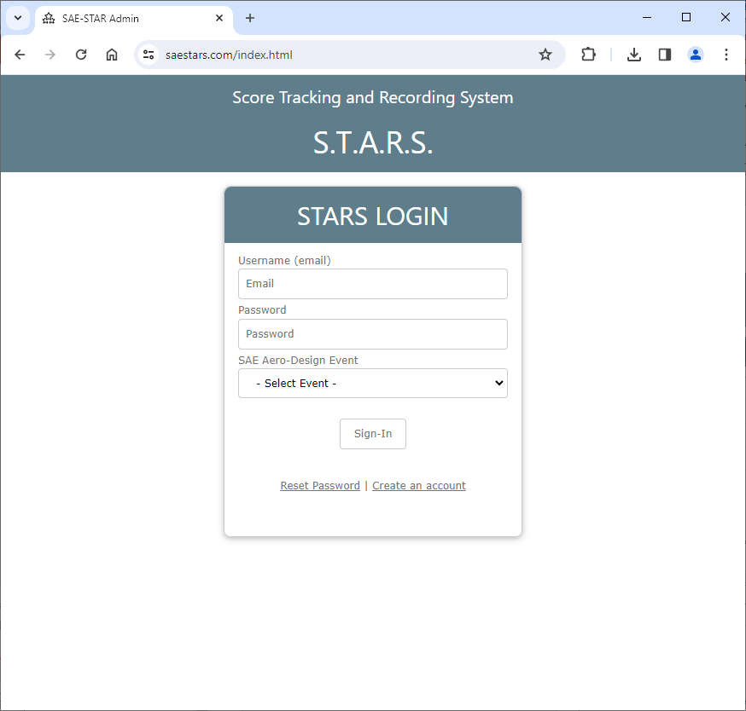
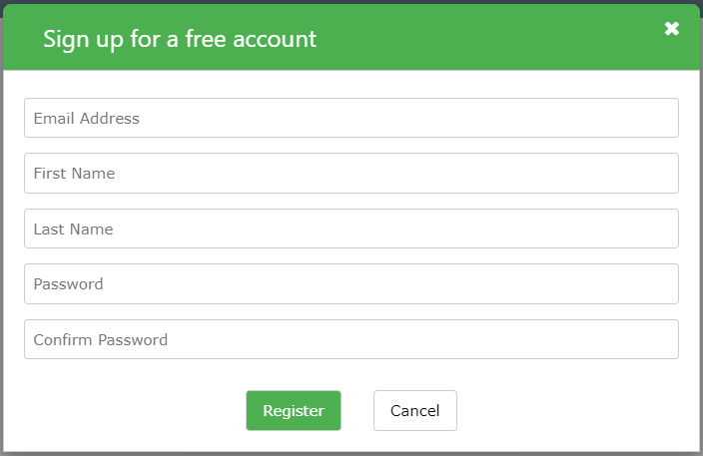
Click on Create an Account Link
Please complete the necessary information in the field and click Register

Slide 3
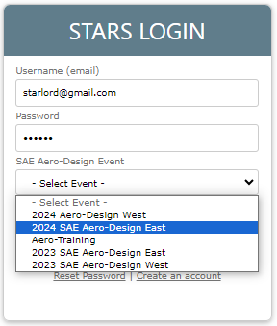
Sign-in with the email and password you used to register for the account.
Make sure you select the correct Event.

Slide 4
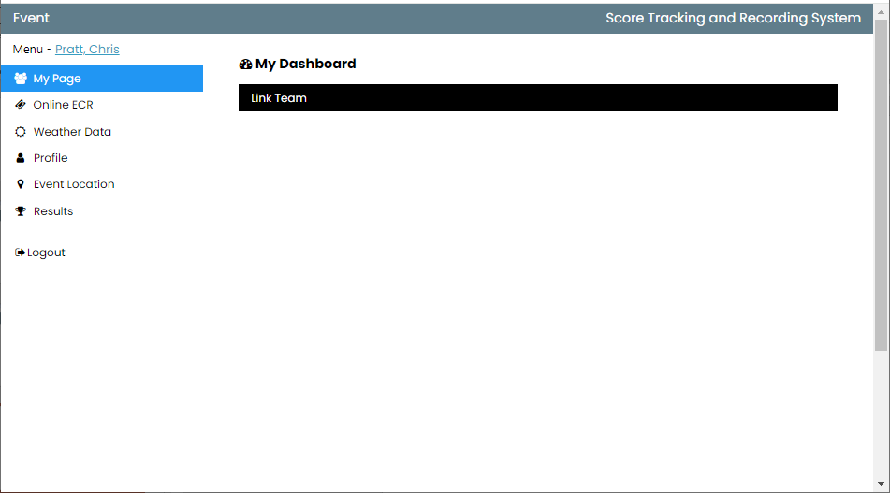
To pair your team with your profile, follow this link and enter your team code. The SAE Staff will provide you with the necessary code, which you’ll need to subscribe and gain access to your team’s scoring details.
Access your Profile
Change your Event Location
Weather Data linked to local weather station and will update with Temperature, Pressure, & Relative Humidity every 5 minutes
Logout
System will keep you logged on for 8 hours before timing out.
View Published Results and standing

Slide 5
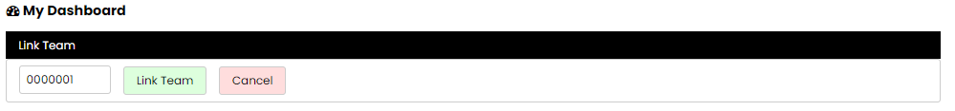
To link your team with your profile, enter your team code. The SAE Staff will provide you with the necessary code, which you’ll need to subscribe and gain access to your team’s scoring details.
Enter your Team Pairing Code
Click Link Team
If you have more than 1 team, you can Link Multiple teams.

Slide 6
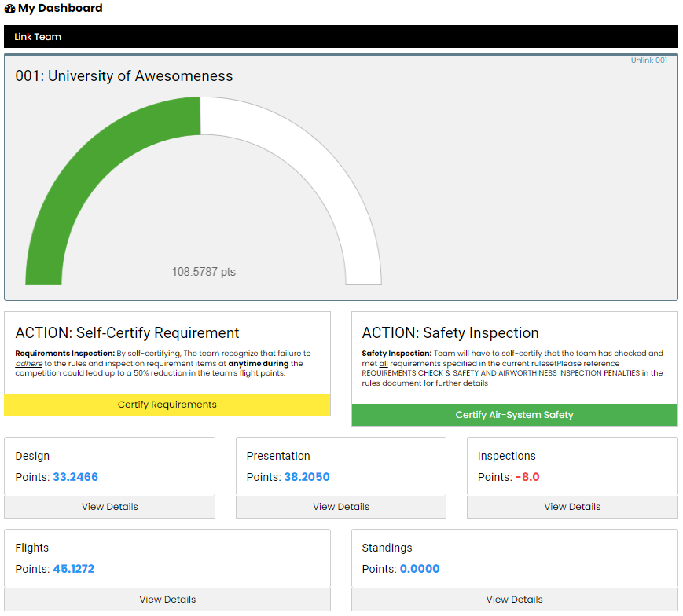
Once you successfully link your team to your profile, your screen will display scoring details.
Unlink/Un-pair
Graphical view of your overall score
Self Certification Status
Yellow: In-Progress
Green: Completed
Self Certification Status
Yellow: In-Progress
Green: Completed
Click on [ Certify Requirement ] to start the process
Click on [ Certify Air-System Safety ] to start the process
Scoring Status for each Segment of the competition.
Click on [ View Details ] to drive further in to the details of each Scoring Segment
Note: Details of your score will only display when the Scoring Lead Publishes the results.

Slide 7
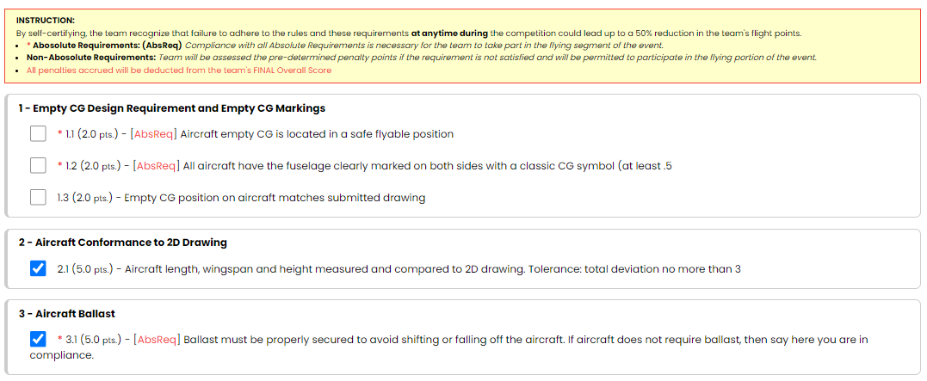
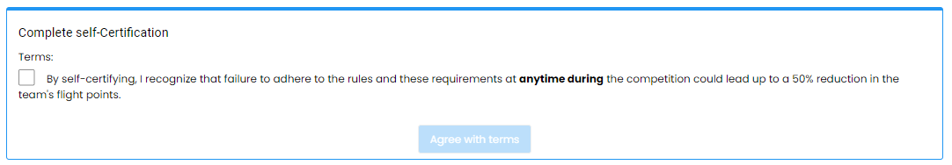
Instructions:
For each requirement, verify and certify that it matches the submitted 3D drawing. Without achieving a “Complete Status” for your self-certification, you will not be permitted to enter the tech inspection.
Note:
  If an item is tagged with AbsReq, it signifies an Absolute Requirement. This implies that the team must be 100% in compliance with the ruleset to participate in the flying segment of the competition. Additionally, apart from ensuring compliance with the rules non-compliance items discovered during initial inspection will result in loss of points, even after the team has brought the aircraft up to being compliant with the rules.
  If an item is not tagged with AbsReq, your team has the option to either address the non-compliance issue or accept penalty points instead. This allows you to participate in the competition even if the item is not fully compliant.
At the bottom of the Self-Certification Page, you will need to agree with the terms of self-certification to complete the self-certification process. Please read and understand the implications of the agreement.
  The Agree with terms button will be enabled once you check the box to agree with the terms.
…

