Slide 1
SAE STARS
User Guide
http://www.saestars.com

Slide 2
Benefits
Realtime score updates
See judge’s feedback
Team Scoring details
Online Engineering Change Request (ECR) [New this year]
Scheduling (To Do List)
  Presentation
  Tech Inspections
  Crash – re-inspections

Slide 3
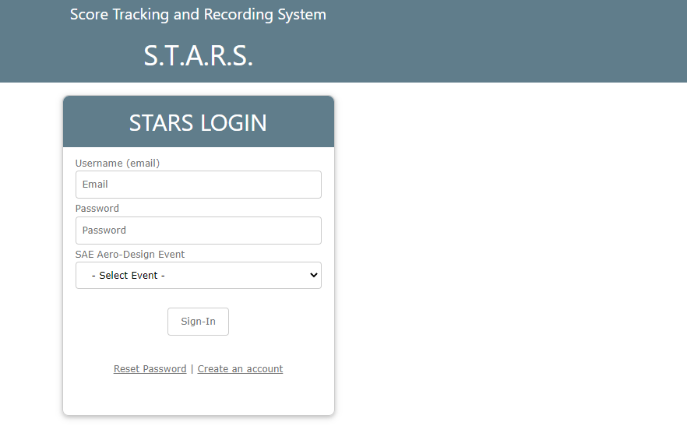
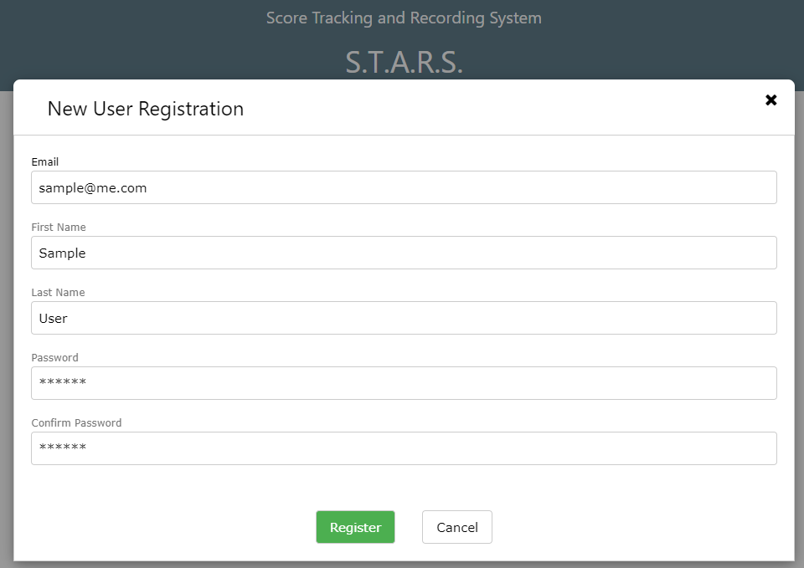
Click on Create an Account Link

Slide 4
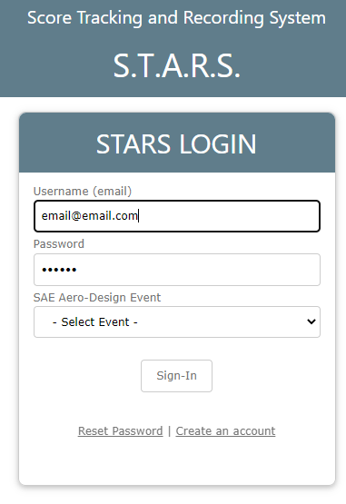
Select your event Database.

Slide 5
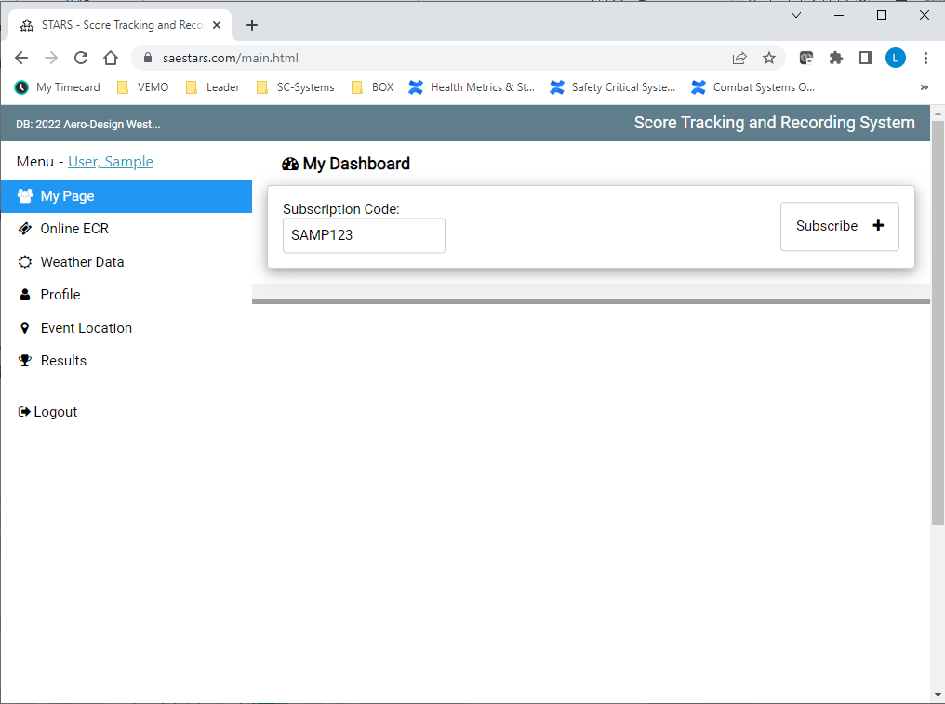
User Profile and Event Database Switching
SAE Staff will provide you with the team code. You will need this to subscribe and get access to your team’s Scoring Details
Online Engineering Change Request. In the past you would submit this on paper. We ask that you fill out this electronic form to make it easier to track and to form assess.
Regular Class will need this to access Weather Data and Density Altitude Calculations

Slide 6
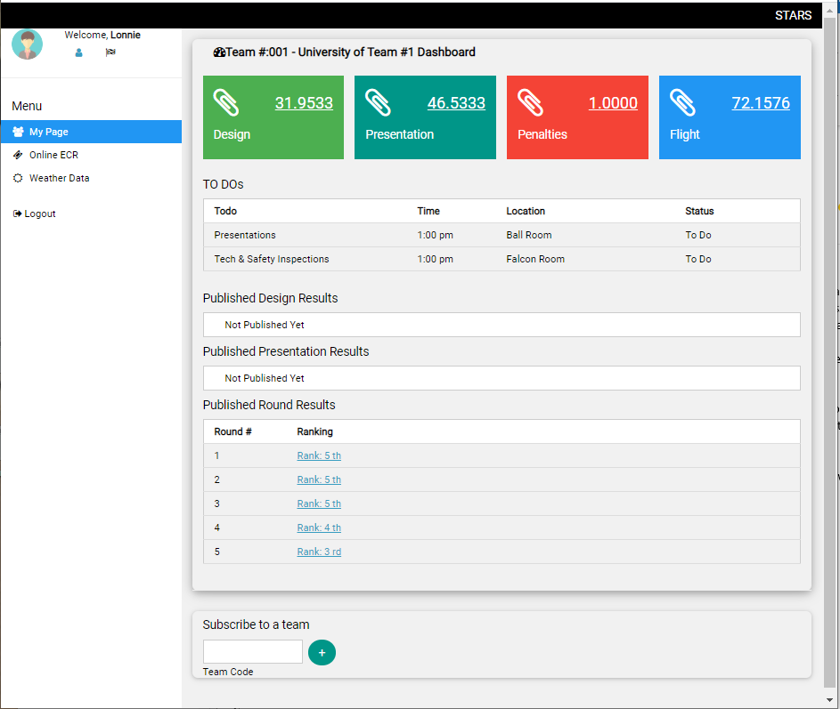
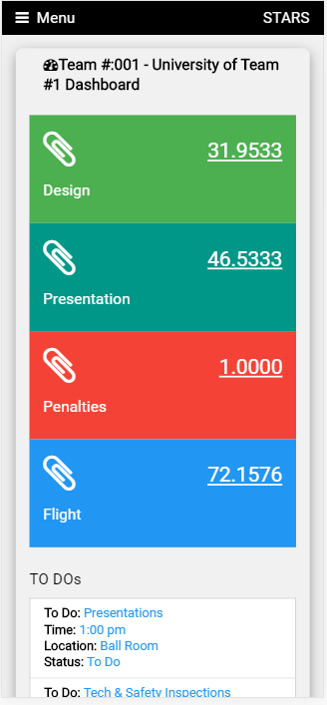
Menu
Computer View
SMART Phone View
Click on Each Tile to drill into the details
Todo’s

